Slide 1
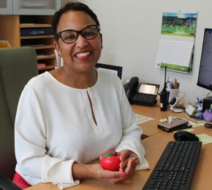
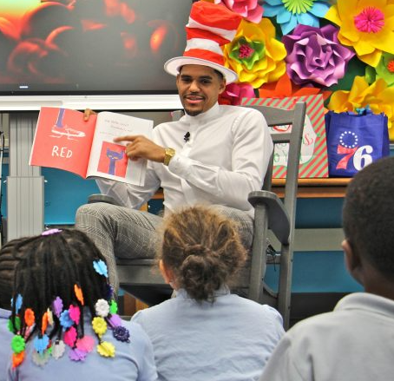
Welcome To Kindergarten! At (your school name)
Insert welcome statement from the Principal
Hi! I’m Ms/Mr Kind. I am so excited to be your Kindergarten educator and I can’t wait to meet you.
I have a dog named Spock and I love Star Trek.

Slide 2
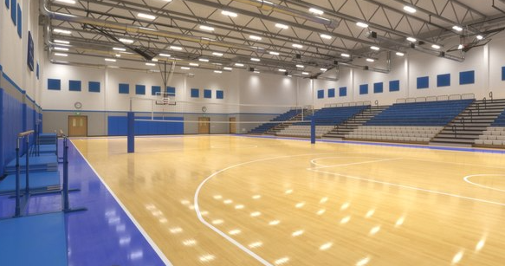
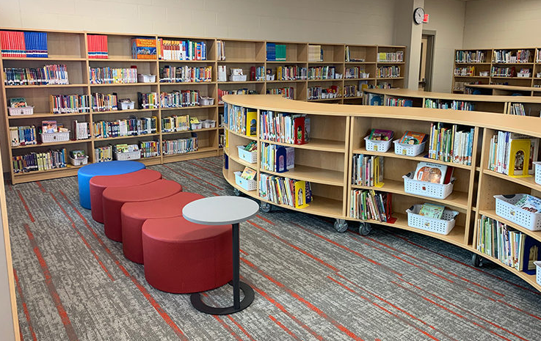
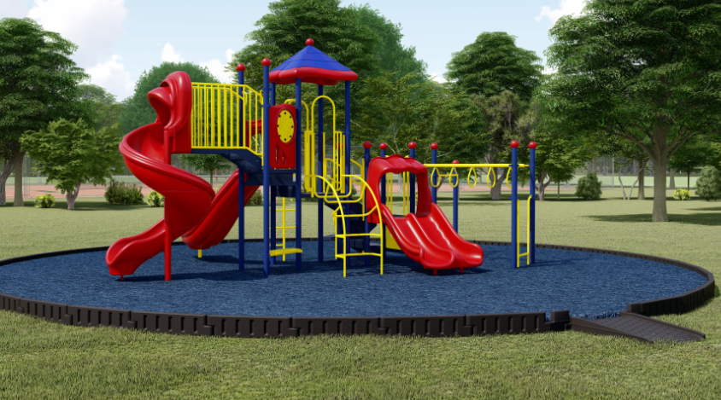
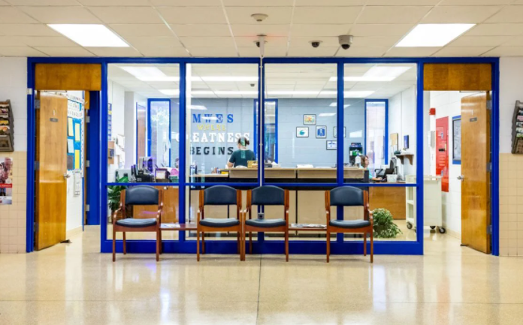
More great people at our School!
This would be a place to insert photographs of people Kindergarten children will encounter at school
(e.g., custodian, secretary, librarian etc.)
Places in our School
Insert an introduction to your school, with photos of the library, gym, outdoor play space etc.

Slide 3
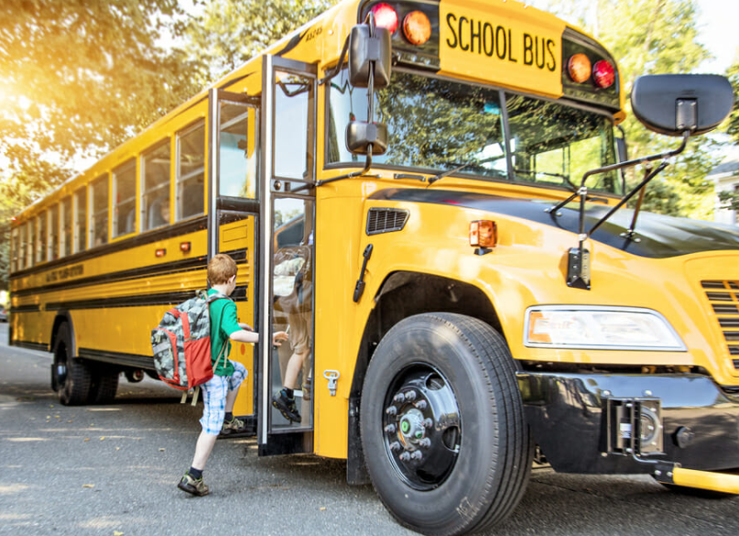
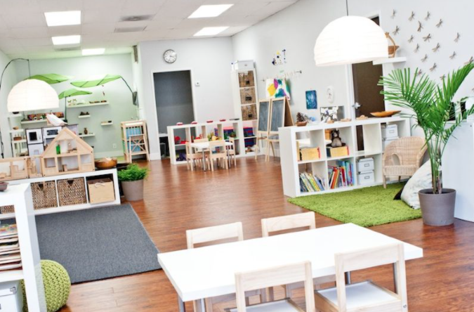
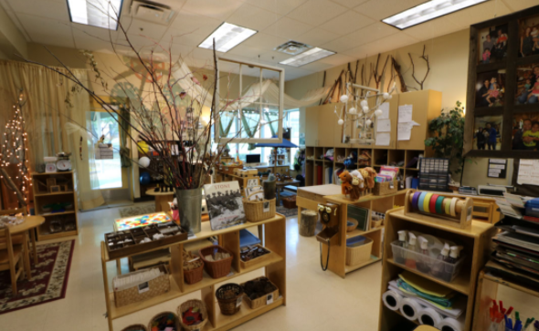
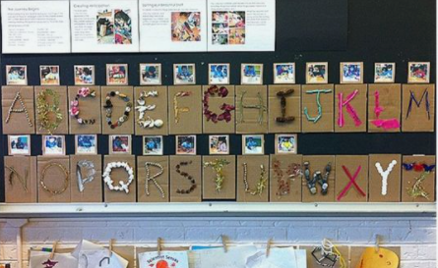
Additional Information About our School
Information such as Lunch program, what children need for school, bus details and any school specific information could be inserted here.
Take a peak into our Kindergarten classroom!
Insert photos of your classroom

Slide 4
Getting Your WTK Bag…
Your WTK bag is filled with many materials to talk, read, create and play together, every day!
You are your child’s first and best teacher!
We’d love to meet you and give you your activity bag with resources to help your child prepare for school.
Date: …………………………………………………
Time: …………………………………………………
Location: ……………………..……………………
Welcome to Kindergarten is brought to you by Canadian Education Warehouse, a national company dedicated to supporting, promoting and advancing education. To find out more or to support this program, please visit
www.welcome-to-kindergarten.ca
today!

